Slide 1

Tourism & Hospitality Data Analysis Using SQL

Slide 2


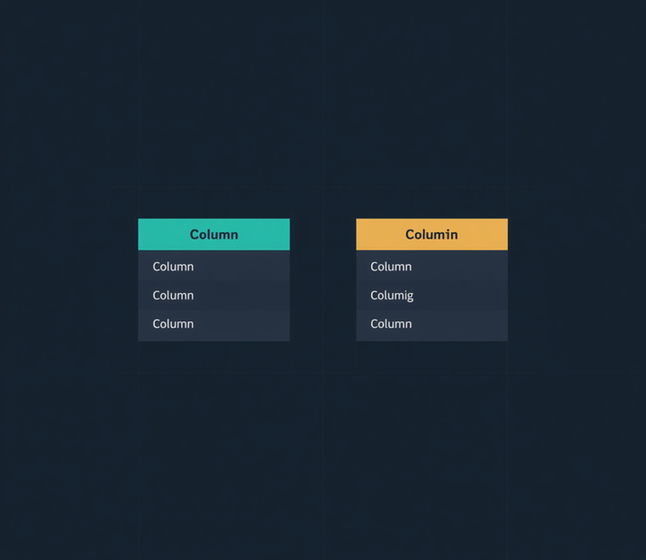

Dataset Overview
tourism_stats
Record_ID · Country · City
Number_of_Tourists · Tourism_Revenue_USD
Avg_Satisfaction_Score
hospitality_stats
Record_ID · Hotel_Name · City
Rooms_Available · Avg_Room_Price_USD
Occupancy_Rate

Slide 3











Import CSV to SQL
Definition
Load data from a CSV file into a SQL table in five simple steps: prepare the CSV, choose the destination table, import and map columns, verify the rows, and run a quick SELECT to confirm the data is ready.
SQL Code
Output
1
Prepare the CSV
Ensure the file is clean and uses a consistentdelimiter (e.g., commas). Remove extra headers or notes.
Rows imported successfully;
data is ready for queries.
2
Create or choose the destination table
Create the table or confirm the target table structure matches your CSV columns.
3
Import/ Map columns
Use LOAD DATA (or your tool's import wizard) to load the CSV and map columns to the table.
LOAD DATA INFILE "FILE.CSV" INTO TABLE TOURISM_STATS FIELDS TERMINATED BY '',
IGNORE 1 LINES;
4
Verify the imported rows
Check the row count and spot-check a few records.
5
Run a quick SELECT
Run a simple SELECT to confirm the data looks correct and is ready for analysis.

Slide 4


Basic Retrieval - Total Records Count
Functionality: COUNT(*) Function
Definition: Calculates the total number of rows present in a specified database table regardless of NULL values.
SQL Code
Output
Key Takeaway: The tourism_stats dataset contains 500 unique entries, providing a robust sample size for statistical analysis across global tourism activities.

Slide 5
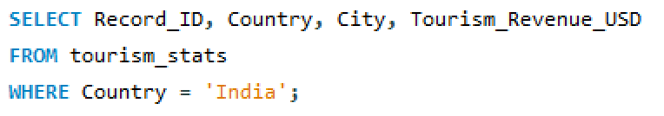
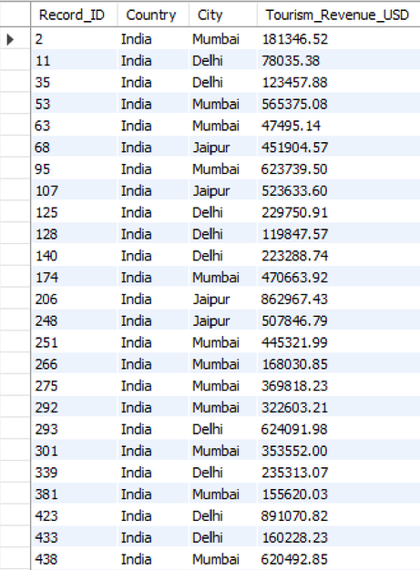
Basic Retrieval - Filter Records by Country
Functionality: WHERE Clause Filtering
Definition: Filters rows from a query result based on a specified comparison condition (e.g., matching string equality).
SQL Code
Output
Key Takeaway: Filtering by Country = 'India' isolates key Indian tourist hubs like Mumbai and Delhi for country-specific regional evaluations.

Slide 6

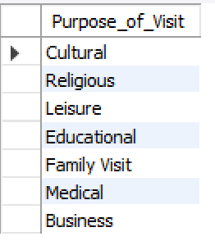
Basic Retrieval - Distinct Purpose of Visit
Functionality: DISTINCT Keyword
Definition: Eliminates duplicate values from the query result set, returning only unique entries for a specified column.
SQL Code
Output
Key Takeaway: Global travel is categorized into 7 distinct visit types, spanning leisure, cultural, medical, business, and educational tourism.

Slide 7
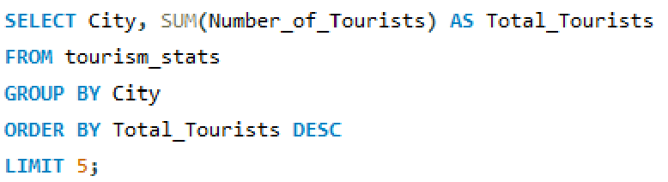
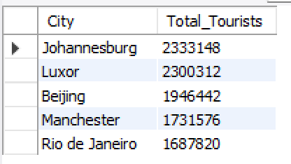
Basic Retrieval - Top 5 Cities by Tourist Volume
Functionality: ORDER BY + LIMIT
Definition: Sorts records in descending order based on aggregate tourist totals and restricts the response to the top N rows.
SQL Code
Output
Key Takeaway: Johannesburg and Luxor lead globally in visitor volume, each exceeding 2.3 million tourists.

Slide 8
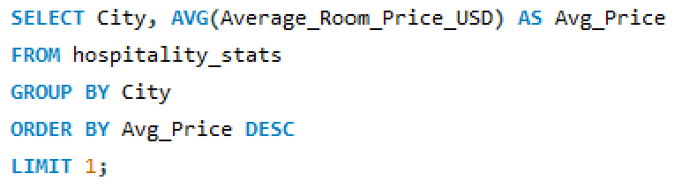

Basic Retrieval - City with Highest Average Room Price
Functionality: AVG() Aggregation with LIMIT 1
Definition: Computes the arithmetic mean of numerical values per group and isolates the single highest value.
SQL Code
Output
Key Takeaway: Puerto Vallarta commands the highest average hotel room rate at $347.11 USD, indicating a premium destination profile.

Slide 9
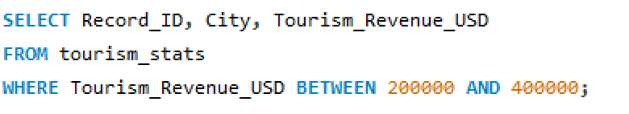
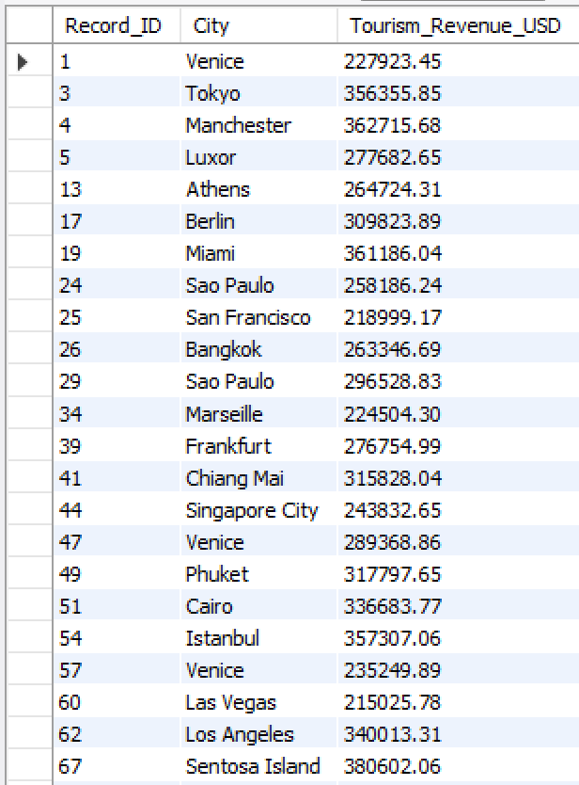
Basic Retrieval - Revenue Range Filtering
Functionality: BETWEEN Operator
Definition: Filters records where column values fall inclusively within a specified lower and upper numerical range.
SQL Code
Output
Key Takeaway: Isolate mid-market destinations generating $200k to $400k revenue per entry, such as Venice and Tokyo.

Slide 10


Aggregate Functions & Grouping - Global Tourism Revenue
Functionality: Total SUM() Aggregation
Definition: Adds together all numerical values in a column to calculate an overall aggregate total.
SQL Code
Output
Key Takeaway: The recorded global tourism dataset accounts for over $174.8 million USD in direct economic revenue.

Slide 11
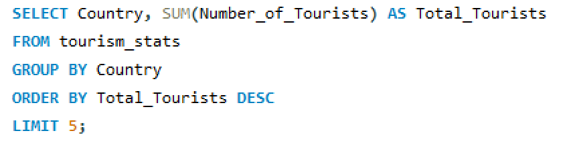
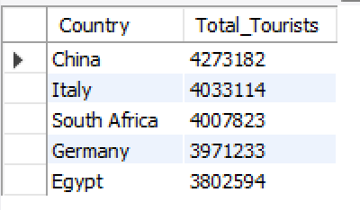
Aggregate Functions & Grouping - Total Tourists Per Country
Functionality: GROUP BY Clause
Definition: Groups individual rows sharing common column values into summary rows for aggregate calculation.
SQL Code
Output
Key Takeaway: China and Italy are the top destination countries, each attracting over 4 million visitors.

Slide 12
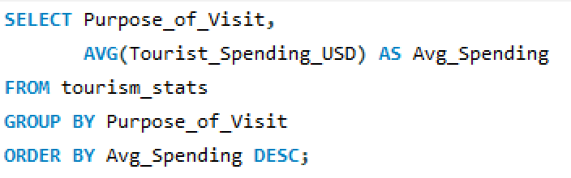
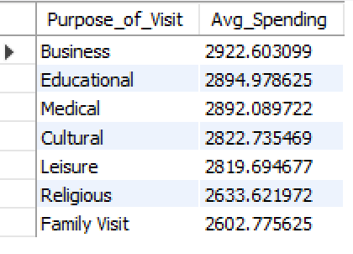
Aggregate Functions & Grouping - Average Tourist Spending by Visit Purpose
Functionality: Category Grouping with AVG()
Definition: Calculates column averages partitioned across distinct categorical values.
SQL Code
Output
Key Takeaway: Business travelers exhibit the highest individual spending per trip at $2,922.60 USD.

Slide 13
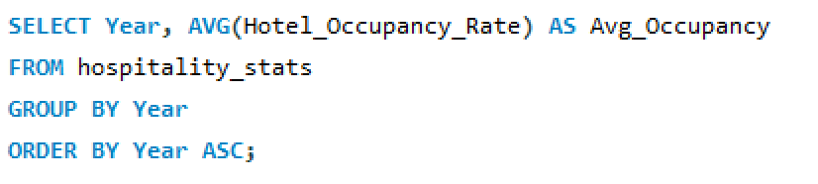
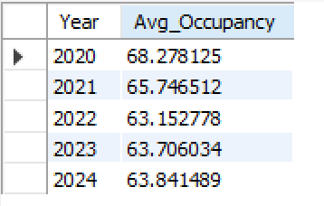
Aggregate Functions & Grouping - Yearly Hotel Occupancy Trend
Functionality: Temporal GROUP BY Aggregation
Definition: Aggregates yearly trends to observe macro-level shifts over time.
SQL Code
Output
Key Takeaway: Global hotel occupancy hovered between 63%–68%, showing stability following 2020.

Slide 14
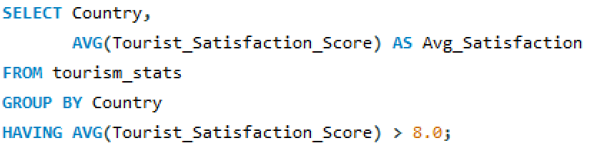

Aggregate Functions & Grouping - High Satisfaction Destinations
Functionality: HAVING Clause Filtering
Definition: Filters grouped result sets based on aggregate condition thresholds (unlike WHERE, which filters individual rows).
SQL Code
Output
Key Takeaway: Egypt is the only country maintaining a national visitor satisfaction average above 8.0 / 10.

Slide 15
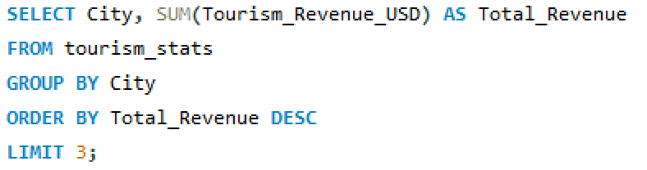
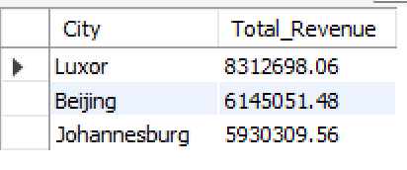
Aggregate Functions & Grouping - Top Revenue Generating Cities
Functionality: Aggregate Sorting & Filtering
Definition: Combines GROUP BY, SUM(), and ORDER BY to find top economic contributors.
SQL Code
Output
Key Takeaway: Luxor generates the highest total revenue at $8.31M USD, outpacing Beijing and Johannesburg.

Slide 16
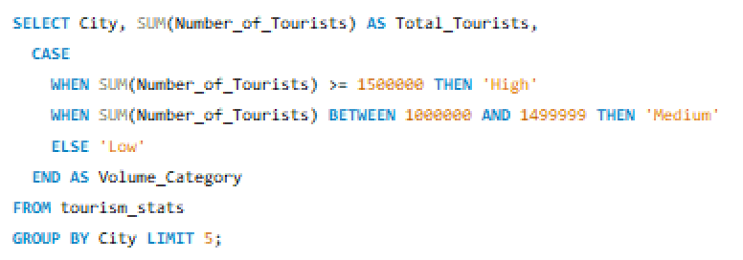
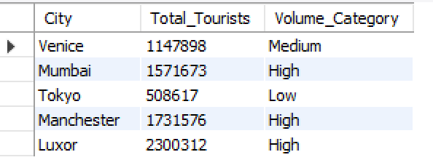
Conditional Logic - Tourist Volume Classification
Functionality: CASE WHEN Conditional Mapping
Definition: Evaluates multiple conditions sequentially and returns a formatted result value when the first condition is met.
SQL Code
Output
Key Takeaway: Classifies markets into tiers (High/Medium/Low) to guide infrastructure allocation.

Slide 17
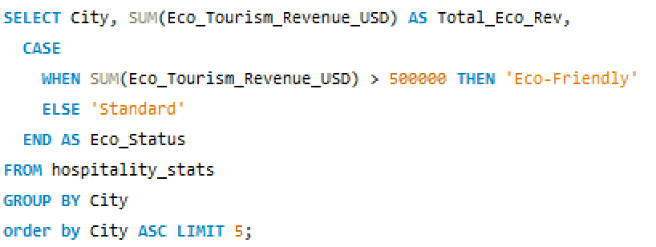
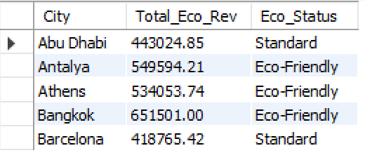
Conditional Logic - Eco-Tourism Flagging
Functionality: Boolean CASE WHEN Categorization
Definition: Dynamically flags records based on eco-revenue parameters.
SQL Code
Output
Key Takeaway: Antalya, Athens, and Bangkok exceed $500k in eco-revenue, qualifying as sustainable hubs.

Slide 18
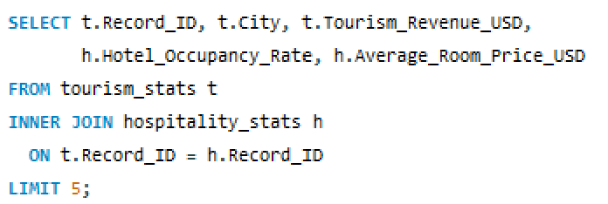
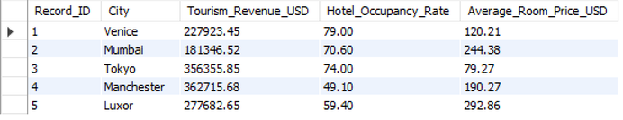
Joins - Combining Tourism & Hospitality Stats
Functionality: INNER JOIN
Definition: Merges rows from two tables where the join predicate condition holds true in both tables.
SQL Code
Output
Key Takeaway: Combines visitor spending with hotel rates to show economic relationships per transaction.

Slide 19
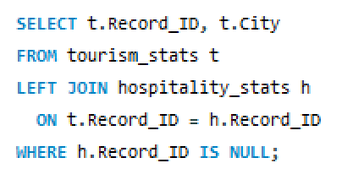

Joins - Unmatched Record Verification
Functionality: LEFT JOIN with IS NULL
Definition: Keeps all records from the left table and returns NULL for missing right-table matches to identify gaps.
SQL Code
Output
Key Takeaway: Confirms 100% relational data integrity between tourism_stats and hospitality_stats.

Slide 20
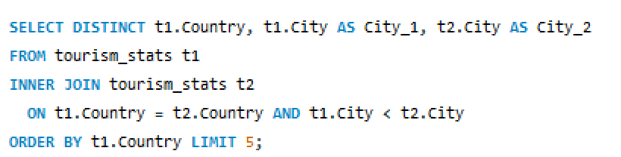
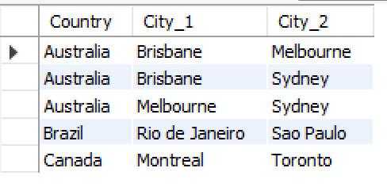
Joins - Intra-Country City Pairing
Functionality: SELF JOIN
Definition: Joins a table to itself to compare records within the same dataset.
SQL Code
Output
Key Takeaway: Maps multi-city travel routes within destination countries like Australia and India.

Slide 21
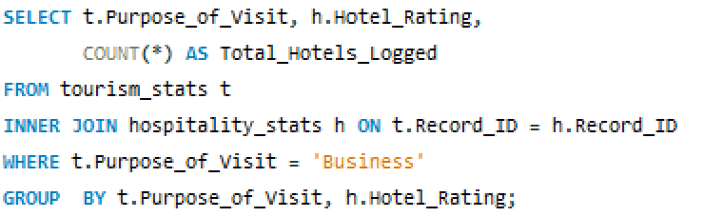
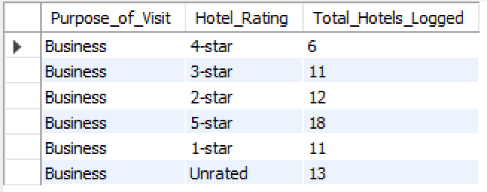
Joins - Hotel Ratings by Purpose of Visit
Functionality: Multi-Table Cross Aggregation
Definition: Aggregates related entries across joined tables to reveal cross-domain patterns.
SQL Code
Output
Key Takeaway: Business travelers log the most stays in 5-star accommodations (18 entries).

Slide 22
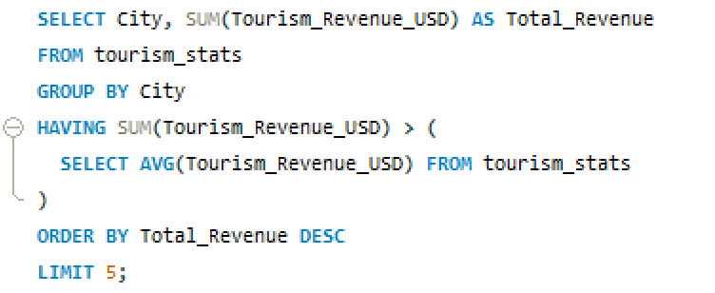
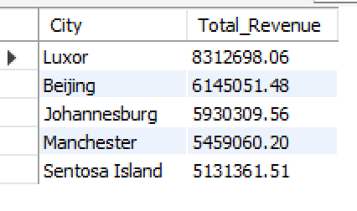
Subqueries & CTEs - Cities Exceeding Average Revenue
Functionality: Scalar Subquery in HAVING
Definition: Uses an inner SELECT query to calculate a benchmark dynamically.
SQL Code
Output
Key Takeaway: Filters out underperforming cities by comparing them against global benchmarks.

Slide 23
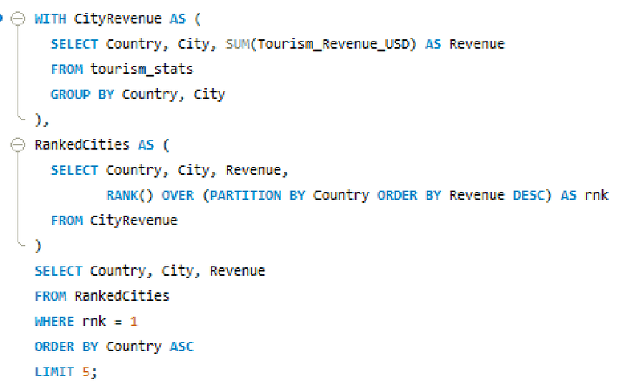
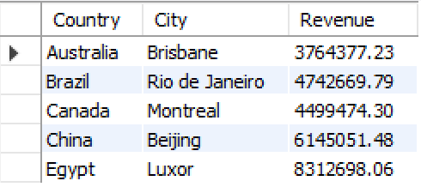
Subqueries & CTEs - Highest Revenue City per Country (Correlated Subquery)
Functionality: Correlated Subquery
Definition: Evaluates an inner query repeatedly for each candidate row processed by the outer query.
SQL Code
Output
Key Takeaway: Identifies top economic driver cities per country, such as Brisbane in Australia and Luxor in Egypt.

Slide 24
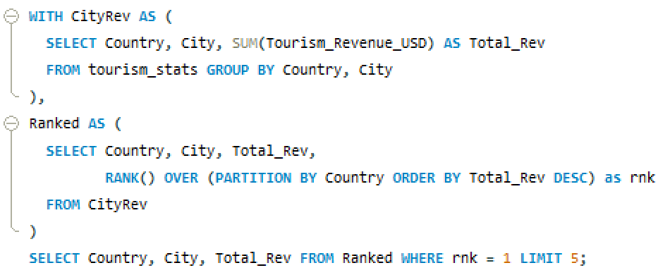
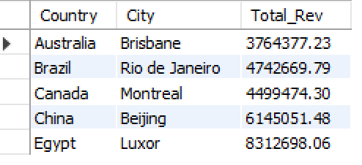
Subqueries & CTEs - Highest Revenue City per Country (CTE Approach)
Functionality: Common Table Expression (WITH Clause)
Definition: Defines a temporary named result set that simplifies query structure and improves readability.
SQL Code
Output
Key Takeaway: Delivers the same outcome as Slide 20 with better query performance and readability.

Slide 25
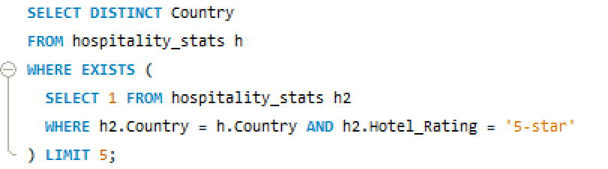
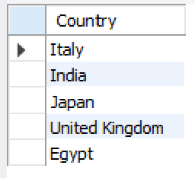
Subqueries & CTEs- Countries with 5-Star Accommodations
Functionality: EXISTS Operator
Definition: Tests for the presence of records in a subquery, returning TRUE as soon as a match is found.
SQL Code
Output
Key Takeaway: Efficiently confirms luxury hotel infrastructure in target markets.

Slide 26
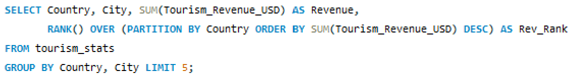
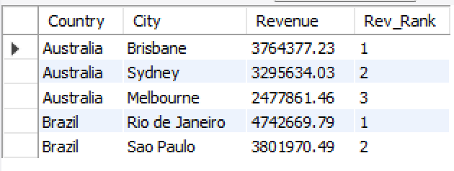
Window Functions - Rank Cities by Revenue within Country
Functionality: RANK() OVER (PARTITION BY)
Definition: Assigns a rank to each row within a partition, leaving gaps when ties occur.
SQL Code
Output
Key Takeaway: Ranks cities by revenue within each country without collapsing individual rows.

Slide 27
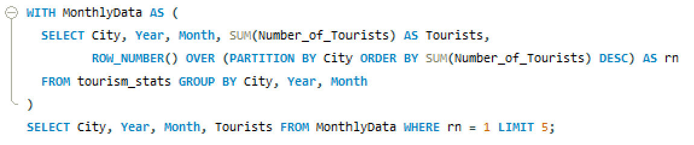
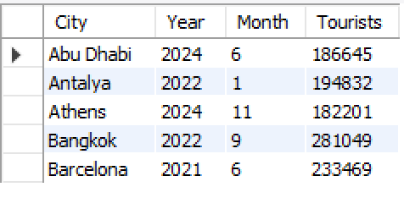
Window Functions- Top Performing Peak Month per City
Functionality: ROW_NUMBER() OVER()
Definition: Assigns a unique sequential integer to rows within a partition, ignoring ties.
SQL Code
Output
Key Takeaway: Pinpoints exact peak travel periods, such as September 2022 for Bangkok (281k tourists).

Slide 28
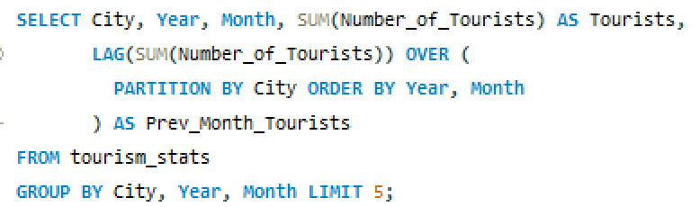
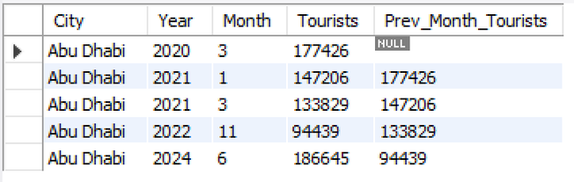
Window Functions - Month-over-Month Tourist Change
Functionality: LAG() Analytic Window Function
Definition: Accesses data from a preceding row in the same result set without using a self-join.
SQL Code
Output
Key Takeaway: Tracks period-over-period visitor changes to highlight seasonal growth and decline trends.

Slide 29
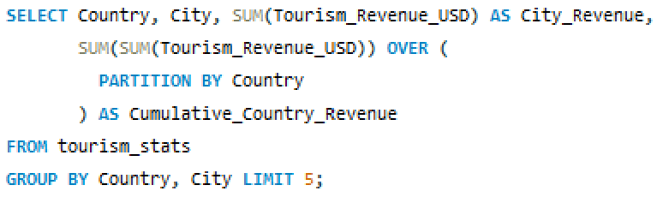
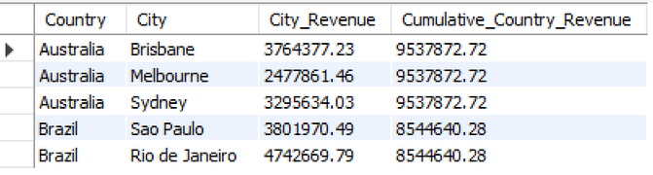
Window Functions - Cumulative Country Revenue Aggregation
Functionality: Window Aggregate SUM() OVER()
Definition: Computes a summary aggregate across a partition while retaining detailed row level records.
SQL Code
Output
Key Takeaway: Displays city-level revenue alongside total national tourism revenue ($9.53M for Australia).

Slide 30
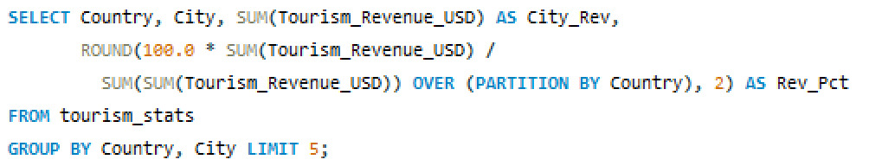
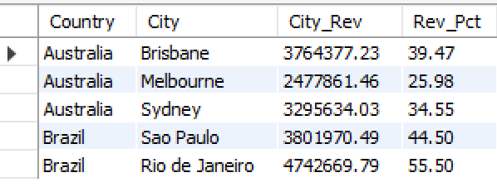
Window Functions - City Percentage Contribution to Country Revenue
Functionality: Proportional Calculation with Window Sum
Definition: Divides individual group metrics by window partition totals to derive percentage contributions.
SQL Code
Output
Key Takeaway: Rio de Janeiro generates 55.5% of Brazil's total national tourism revenue.

Slide 31
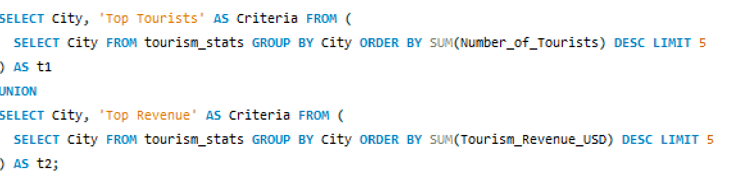
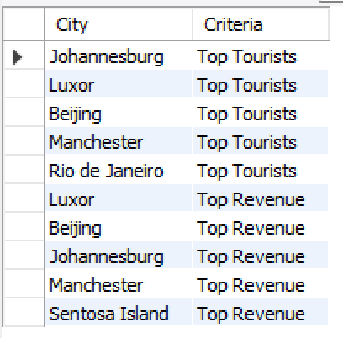
Set Operations, String & Date Functions - Combining Top Cities Sets
Functionality: UNION Operator
Definition: Combines result sets from multiple queries and removes duplicate records.
SQL Code
Output
Key Takeaway: Beijing, Johannesburg, Luxor, and Manchester lead in both visitor volume and overall revenue.

Slide 32
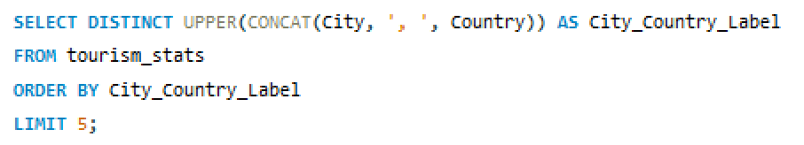

Set Operations, String & Date Functions - Formatted Geographic Label String Creation
Functionality: String Formatting (UPPER & CONCAT)
Definition: Converts strings to uppercase and concatenates columns for standardized text formatting.
SQL Code
Output
Key Takeaway: Standardizes location identifiers for consistent display across reporting tools and dashboards.

Slide 33


Set Operations, String & Date Functions - Quarterly Visitor Volume Analysis
Functionality: Date Bucket Aggregation
Definition: Groups monthly numerical records into calendar quarters (Q1–Q4) for seasonal evaluation.
SQL Code
Output
Key Takeaway: Global tourist volume peaks in Q1 and Q3 (~16.3M visitors) and drops to its lowest level in Q4 (14.08M visitors).

Slide 34
All Concepts at a Glance
Concept
Mini-Snippet
Output Summary
SELECT / WHERE
SELECT country, city FROM tourism_stats WHERE Country = 'France';
Filters rows and returns only matching records
ORDER BY / LIMIT
SELECT * FROM tourism_stats ORDER BY Tourism_Revenue_USD DESC LIMIT 5;
Shows the top 5 rows by revenue
Aggregates
SELECT SUM(Tourism_Revenue_USD), AVG(Avg_Satisfaction_Score) FROM tourism_stats;
Returns totals and averages
GROUP BY / HAVING
SELECT City, COUNT(*) FROM tourism_stats GROUP BY City HAVING COUNT(*) > 1;
Groups rows and filters groups
CASE WHEN
SELECT City, CASE WHEN Occupancy_Rate >= 80 THEN 'High' ELSE 'Low' END AS Occupancy_Level FROM hospitality_stats;
Creates conditional labels
INNER JOIN
SELECT * FROM tourism_stats t INNER JOIN hospitality_stats h ON t.Record_ID = h.Record_ID;
Keeps only matching rows from both tables
LEFT JOIN
SELECT * FROM tourism_stats t LEFT JOIN hospitality_stats h ON t.Record_ID = h.Record_ID;
Keeps all left-table rows, NULLs for missing
Subquery
SELECT * FROM tourism_stats WHERE Tourism_Revenue_USD > (SELECT AVG(Tourism_Revenue_USD) FROM tourism_stats);
Filters using a computed threshold
CTE
WITH city_totals AS (SELECT City, SUM(Tourism_Revenue_USD) AS total FROM tourism_stats GROUP BY City) SELECT * FROM city_totals;
Breaks complex logic into a named step
Window Function
SELECT City, Tourism_Revenue_USD, RANK() OVER (PARTITION BY City ORDER BY Tourism_Revenue_USD DESC) AS rank FROM tourism_stats;
Adds rank without collapsing rows
UNION
SELECT Country FROM tourism_stats UNION SELECT City FROM hospitality_stats;
Combines distinct rows from multiple queries

